Slide 1

University College of Engineering, Tindivanam
(A Constituent College of Anna University, Chennai)
Department of Information Technology
TITLE
Multi-Modal Smart Contract Vulnerability Detection Using Big Data
BATCH NO: 02
SUPERVISOR: Dr. R. Shyamala, M.E., Ph.D., AP/IT
Team Members:
422422205003 RAGURAMAN M
422422205018 DHINESH KUMAR V
422422205052 SELVA KUMAR K
422422205055 RABINSON R

Slide 2
S.No | Paper (Author,Title, Journal Name,Year) | Key Idea / Approach | Advantages | Disadvantages | Evaluation Metrics | Data Set (if required)
1 | Lian et al., "A Universal and Efficient Multi-Modal Smart Contract Vulnerability Detection Framework for Big Data," IEEE Trans. on Big Data, 2025. | A dual-stream framework fusing code text (Word2Vec) and logic flow (Joint Feature Graphs) using a Hybrid GNN. | High Precision Scalability Comprehensive Analysis | Resource Intensive Context Loss | 2. False Alarm Rate (FAR): 0.63% | .
2 | Lin et al., "A Lightweight vulnerability detection method for long smart contracts based on bimodal feature fusion," Cybersecurity, 2025. | Bimodal fusion of Source Code and Opcode using a Hierarchical Attention Network (HAN) with Bi-GRU for long contracts. | Handles Long Contracts High Efficiency Complex Feature Fusion | Data Dependency Preprocessing Overhead
SmartBugs-Wild: 47,000+ unique real-world contracts from Ethereum.
1.Detection Rate (Accuracy): 97.01%
1.Accuracy: High performance in long contract classification
Ethereum Dataset: Real-world samples from SmartBugs-Wild and labeled vulnerability types.
2.Detection Time: ~0.99s (Efficiency metric).

Slide 3
3 | Bresil et al., "Deep Learning-Based Vulnerability Detection Solutions in Smart Contracts: A Comparative and Meta-Analysis," IEEE Access, 2025. | Meta-analysis of serial and parallel CNN-BiLSTM architectures. | Superior Generalization Balanced Performance Robust Dataset. | Source Code Dependency Lower Binary Performance | 1.F1-Score: Balances Precision and Recall. 2.Precision: Minimizes false alarms (False Positives). | SolidiFI-benchmark & SmartBugs Curated: Diverse datasets with systematically injected bugs.
4 | Raju et al., "AI in Blockchain Security: Detecting Anomalies in Smart Contracts," ICoICI, 2025. | GBC-driven framework for real-time contract execution anomaly detection. | Proactive Security Strong Detection Minimized False Positives | Feature Dependency Lack of Explainability | 1.Detection Rate: 92.99%. 2.FalseAlarm Rate(FAR): Minimized to 0.63% in optimized tests. | SmartBugs & Custom Solidity Library: Combined known vulnerable contracts
5 | Xu et al., "Enhanced Smart ContractVulnerabilityDetection via Graph Neural Networks," IEEE Trans. on Software Engineering, 2025. | Dual-input framework (BSGVD) extracting Abstract Syntax Graphs (ASG) and Control Flow Graphs (CFG) via GNNs. | High Accuracy Broad Coverage Deep Structural Analysis | Extreme Resource Demands Complex Data Preparation | 1.Average Accuracy (95.78%) 2.F1-Score (93.80%) | Real Ethereum Dataset: 25,350 contracts labeled with Slither and cross-validated with historical exploits.

Slide 4
Problems We Analyzed:
Long smart contracts suffer from context loss and complex vulnerabilities that single-modal methods miss, so bimodal feature fusion (code + semantic flow) with lightweight models like GRU/GAT/1D-CNN is needed for accurate, efficient detection
Existing deep learning methods for smart contract vulnerability detection are limited by context loss and complexity, so bimodal feature fusion (code + semantic flow) with models like BiLSTM, Transformer-lite, or GraphSAGE is needed for accurate and efficient detection
To detect anomalies in smart contracts, this work uses bimodal feature fusion (code + semantic flow) with BiLSTM, Transformer-lite, or GraphSAGE for accurate and efficient detection
Existing smart contract vulnerability detection methods struggle with long contracts and complex flows, so this work uses Graph Neural Networks (GNNs) with bimodal feature fusion of code and semantic flow for accurate and efficient detection

Slide 5
Problem Statement and Objectives:
Problem Statement
Detecting and Localizing Vulnerabilities of Smart Contracts using GNNSE (Graph Neural Networks with Symbolic Execution) for bigdata
Objectives:
Dataset: Large-scale collections like XBlock-ESC or Smart-Check, containing over 50,000 labeled Ethereum and Vntchain contracts.
Code Embedding & Control Flow Analysis: Converts Solidity into Control Flow Graphs (CFG) and Data Flow Graphs (DFG), then uses Word2Vec or CodeBERT to transform logical nodes into high-dimensional vectors for semantic understanding.
Models Taken: A hybrid pipeline pairing a Temporal Message Propagation (TMP) GNN (for rapid high-risk filtering)
with a Z3-backed Symbolic Execution Engine (for precise path verification and localization)..
Parameters to be Studied: Detection Confidence Threshold ($\tau$), Symbolic Path Depth, Message-Passing Hops, and
Dropout Rates to balance detection speed with the reduction of false positives.

Slide 6
Proposed Solution
Description
Concept: We propose a GNNSE-based Smart Contract Vulnerability Detection and Localization System that integrates Graph Neural Networks (GNN) with Symbolic Execution (SE) to efficiently analyze large-scale smart contract datasets. The system is designed to address both vulnerability detection and precise localization by combining graph-based learning for scalability with symbolic execution for execution-path accuracy. Graph Neural Networks are employed to model smart contracts as graphs derived from Abstract Syntax Trees (AST), Control Flow Graphs (CFG), and Data Flow Graphs (DFG), enabling the system to learn complex structural and dependency patterns. Symbolic Execution is selectively applied to high-risk regions identified by the GNN to accurately localize vulnerabilities at the function, variable, and line level.
Value Proposition: This solution addresses scalability and localization limitations in existing smart contract security tools. GNN-based learning filters and prioritizes suspicious contracts, while Symbolic Execution confirms and localizes vulnerabilities, reducing false positives and enabling efficient auditing of large-scale blockchain data.

Slide 7
Key Features
• Structural-aware vulnerability detection using GNNs • Precise vulnerability localization using symbolic execution • Scalable analysis for big data smart contract repositories • Detection of multiple vulnerability types
Novelty & Uniqueness
The proposed system uniquely integrates graph learning with symbolic reasoning. Unlike traditional approaches, it supports both large-scale detection and precise localization, making it suitable for real-world blockchain auditing.
Feasibility of Idea
The system leverages mature deep learning frameworks and symbolic execution tools. Publicly available datasets and standard computing infrastructure ensure feasibility for academic and practical deployment.

Slide 8
Software and Hardware Requirements:
Category | Component | Requirement Details
Software | Programming Language | Python 3.9+ and Solidity (for source code analysis)
 | DL Frameworks | PyTorch and PyTorch Geometric (for GNN modeling)
 | Symbolic Execution | Z3 Theorem Prover, Slither, or Mythril (for localization)
 | Data Processing | Solidity-Antlr (for AST parsing), NumPy, and Pandas
 | Web Interface | Streamlit (Frontend & User Dashboard)
 | Datasets | XBlock-ESC, Smart-Check, or SmartBugs-Wild (50k+ contracts)

Slide 9
Hardware | Processor (CPU) | Minimum: Intel i5 / Ryzen 5; Recommended: Intel i7 / Ryzen 7
 | Graphics (GPU) | Required for Training: NVIDIA RTX 3060+ or Google Colab T4/A100
 | System RAM | Minimum: 8 GB; Recommended: 16 GB - 32 GB for large graph processing
 | Storage | 100 GB SSD (NVMe preferred for fast dataset I/O)
 | Network | Stable internet connection for model hosting and cloud API access
Deployment | Environment | Google Colab (with LocalTunnel)
 | Client Device | Any device with a modern web browser (Chrome/Firefox)

Slide 10
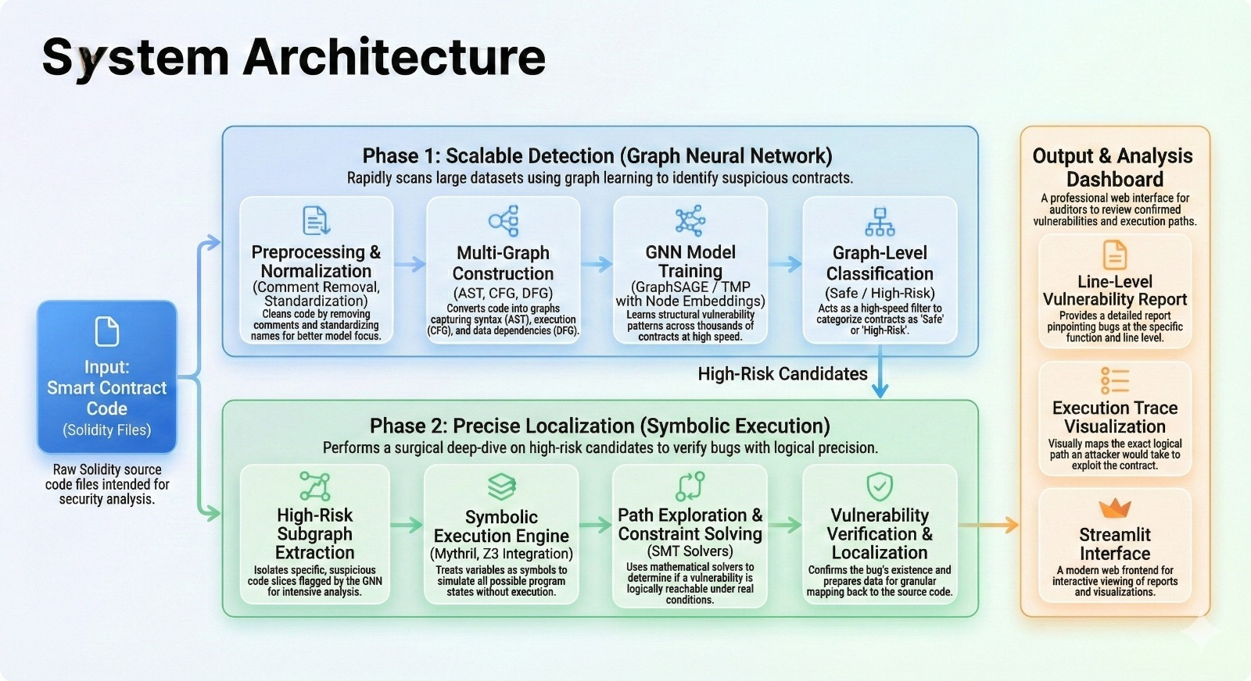

Slide 11
References:
T. Nguyen, K. T. Vo, T.-T. Ta, T.-A. Nguven-Hoang, and N.-T. Dinh, “Thebenefits and challenges of applying blockchain technology into big data:A literature review,” in Proc. Int. Conf. Adv. Technol. Commun., 2022,pp. 219–224. https://ieeexplore.ieee.org/document/10535206
G. Ramakrishnan, M. Rehan, and G. Sujatha, “Solidity vulnerabilityscanner,” in Proc. Int. Conf. Data Sci. Agents Artif. Intell., 2022, pp. 1–5. https://ieeexplore.ieee.org/document/10535206
B. Jia, X. Zhang, J. Liu, Y. Zhang, K. Huang, and Y. Liang, “Blockchain-enabled federated learning data protection aggregation scheme with diferential privacy and homomorphic encryption in IIoT,” IEEE Trans. Ind.Informat., vol. 18, no. 6, pp. 4049–4058, Jun. 2022. https://ieeexplore.ieee.org/document/10535206
M. I. Mehar et al., “Understanding a revolutionary and flawed grandexperiment in blockchain: The DAO attack,” J. Cases Inf. Technol.,vol.21,no. 1, pp. 19–32, 2019. https://ieeexplore.ieee.org/document/10535206
L. Luu, D.-H. Chu, H. Olickel, P. Saxena, and A. Hobor, “Making smartcontracts smarter,” in Proc. ACM SIGSAC Conf. Comput. Commun. Secur.,2016, pp. 254–269. https://ieeexplore.ieee.org/document/10535206

